Slide 1

CUDA
“Compute Unified Device Architecture”
General purpose programming model
  User kicks off batches of threads on the GPU
  GPU = dedicated super-threaded, massively data parallel co-processor

Slide 2
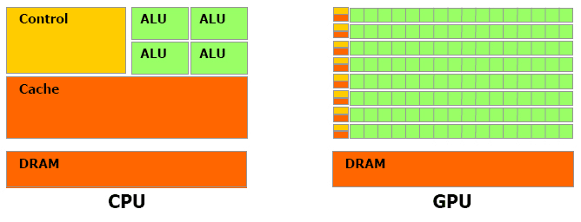
Quick Architectural View

Slide 3
Intel 7 (Multi-Core architectures)
  4 cores, Full X86 instructions
  Hyperthreading with two HW threads
  Designed to maximize the execution speed of sequential programs
Many-Core (GPU’s)
  Focus on throughput of parallel applications
  Long number of MUCH smaller cores
    This # grows with each new GPU generation
  Leading the floating point race, since 2003

Slide 4
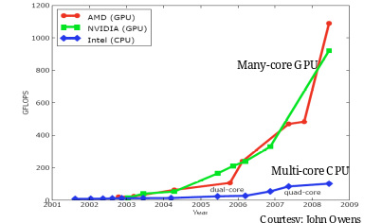
Why Massively Parallel Processing?
A quiet revolution and potential build-up
  Calculation: TFLOPS vs. 100 GFLOPS
  Memory Bandwidth: ~10x
  GPU in every PC– massive volume and potential impact

Slide 5
Why the parallel Gap is important
Developers want to get things done faster
Developers were and are motivated to move the intensive computational intensive parts of their SW to GPUs for execution.
At the end of the day, we want to do more per unit of time

Slide 6
Let’s get back to this once again
  CPU
  Optimized for sequential code performance
  Sophisticated control logic to allow a single thread of execution to execute in parallel or even out of their sequential order while maintaining of sequential execution.
  Large cache memories added to reduce the instruction and data access latencies of large complex applications
  Cache and Control Logic DO NOT contribute to PEAK calculation speed.

Slide 7
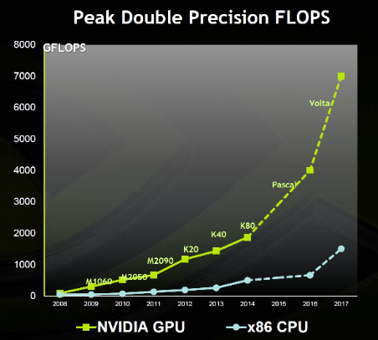

Slide 8
Let’s get back to this once again
  GPU
  Shape by the Billion Dollar ($) video game industry
  Multimedia is incredibly demanding, concurrent processing of audio and video.
  GPU’s can perform a massive number of floating point calculations per video game frame.
  Optimized for execution throughput of massive number of threads
  HW takes advantage of the large # of execution threads to find out work to do while others are waiting for long-latency memory access → means? Control logic for execution thread is reduced
  Small Caches
    Help to control the bandwidth → Multiple threads accessing the same data do not have to go to DRAM

Slide 9
are GPU’s better at everything
Answer: NO.
GPU’s are numeric computational engines
They will not do well in some task where CPU excel.
And CPU’s will not do Well in some task where GPU’s excel.

Slide 10
SO…… I am confused now
Simple:
Most of the applications will use both CPU & GPU’s.
  CPU → sequential parts
  GPU → numerical intensive parts
  How do we achieve such objective →
CUDA (Compute Unified Device Architecture)
  Is designed to support joint CPU/GPU execution of an application

Slide 11


CPU vs GPU (Sequential Processing)
CPU Cores
GPU Cores

Slide 12


CPU vs GPU (Parallel Processing)
CPU Cores
GPU Cores

Slide 13

CPU vs GPU
CPU vs GPU -Did you get it? No Problem
CPU + GPU

Slide 14
G80 CUDA mode – A Device Example
Host
Input Assembler
Thread Execution Manager
Parallel Data
Cache
Parallel Data
Cache
Parallel Data
Cache
Parallel Data
Cache
Parallel Data
Cache
Parallel Data
Cache
Parallel Data
Cache
Parallel Data
Cache
Texture
Texture
Texture
Texture
Texture
Texture
Texture
Texture
Texture
Load/store
Load/store
Load/store
Load/store
Load/store
Load/store
Global Memory

Slide 15
Looking inside a GPU
Organized into an array of highly threaded Streaming Multiprocessors (SM’s).
Two SM’s form a Block.
  The # of SM’s in a Block can vary from generation to generation (VERY IMPORTANT)
  Each SM has a number of Streaming Processors (SP’s)
    SP’s share {control logic, and instruction cache}
Global Memory
  In some cases more than 4 GB
  Graphic Double Data Rate (GDDR) DRAM

Slide 16
Looking inside a GPU
  Important Naming Conventions:
    GPU → Device
    CPU → Host
  Lets continue taking about that memory
  Graphic Double Data Rate (GDDR) DRAM differs from the DRAM that you will find in the CPU in the following aspects:
    GDDR DRAM is essentially a frame buffer used for graphics
      WE ARE NOT DOING THIS
    For Computation:
      Works like a vey-high-bandwidth, off chip memory BUT with some more latency than typical memory. HOWEVER →
      For massively parallel applications Higher Bandwidth MAKES UP for the longer latency.

Slide 17
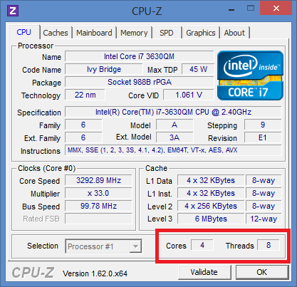

Slide 18
Two EXAMPLES (already old)
The G80
128 SP’s, organized as follows
  16 SM’s, each with 8 SP’s
  Each SM can support up to 768 threads
  That gives us →
    (16 SM)*(768 Threads/ (1 SM)) = 12288 threads
The GT200
1024 threads per SM → ~30000 Threads

Slide 19
3rd EXAMPLE
The K40 Tesla
2880 SM’s
How many threads → MANY-MANY more than the previous two examples.

Slide 20
Parallel Programming Basics
Things we need to consider:
  Control
  Synchronization
  Communication
Parallel programming languages offer different ways of dealing with above

Slide 21
LET’S TALK ABOUT THIS
Data parallelism
Task parallelism
Host
  Host memory
Device
  Device memory
KERNEL
CUDA Thread
  What they are

Slide 22
CUDA /OpenCL – Execution Model
Integrated host+device app C program
  Serial or modestly parallel parts in host C code
  Highly parallel parts in device SPMD kernel C code
Serial Code (host)‏
Parallel Kernel (device)‏
KernelA<<< nBlk, nTid >>>(args);
. . .
Serial Code (host)‏
Parallel Kernel (device)‏
KernelB<<< nBlk, nTid >>>(args);
. . .

Slide 23
Vector Addition – Conceptual View
vector A
A[0]
A[1]
A[2]
A[3]
A[4]
A[N-1]
…
vector B
B[0]
B[1]
B[2]
B[3]
B[4]
…
B[N-1]
+
+
+
+
+
+
vector C
C[0]
C[1]
C[2]
C[3]
C[4]
C[N-1]
…

Slide 24
Vector Addition – Traditional C Code
// Compute vector sum C = A+B
void vecAdd(float* A, float* B, float* C, int n)
{
for (i = 0, i < n, i++)
C[i] = A[i] + B[i];
}
int main()
{
// Memory allocation for A_h, B_h, and C_h
// I/O to read A_h and B_h, N elements
…
vecAdd(A_h, B_h, C_h, N);
}

Slide 25
Heterogeneous Computing vecAdd Host Code
Part 1
#include <cuda.h>
void vecAdd(float* A, float* B, float* C, int n)‏
{
int size = n* sizeof(float);
float* A_d, B_d, C_d;
…
1. // Allocate device memory for A, B, and C
// copy A and B to device memory
2. // Kernel launch code – to have the device
// to perform the actual vector addition
3. // copy C from the device memory
// Free device vectors
}
Host Memory
Device Memory
CPU
GPU
Part 2
Part 3

Slide 26
Partial Overview of CUDA Memories
Device code can:
  R/W per-thread registers
  R/W per-grid global memory
Host code can
  Transfer data to/from per grid global memory
(Device) Grid
Block (0, 0)
Block (1, 0)
Registers
Registers
Registers
Registers
Thread (0, 0)
Thread (1, 0)
Thread (0, 0)
Thread (1, 0)
We will cover more later. Do not worry
Host
Global
Memory
Notes:
Global, constant, and texture memory spaces are persistent across kernels called by the same application.

Slide 27
STOP HERE FOR A SEC
Before we talk more about CUDA we need to talk a little bit more about GPU memory and learn a couple of things about it

Slide 28
CUDA Memory Model Overview
Global memory
  Main mean of communicating R/W Data between host and device
  Contents visible to all threads
  Long latency access
We will focus on global memory for now
  Constant and texture memory will come later
Grid
Block (0, 0)‏
Block (1, 0)‏
Shared Memory
Shared Memory
Registers
Registers
Registers
Registers
Thread (0, 0)‏
Thread (1, 0)‏
Thread (0, 0)‏
Thread (1, 0)‏
Host
Global Memory

Slide 29
CUDA Device Memory Allocation
cudaMalloc()
  Allocates object in the device Global Memory
  Requires two parameters
    Address of a pointer to the allocated object
    Size of of allocated object
cudaFree()
  Frees object from device Global Memory
    Pointer to freed object
Grid
Block (0, 0)‏
Block (1, 0)‏
Shared Memory
Shared Memory
Registers
Registers
Registers
Registers
Thread (0, 0)‏
Thread (1, 0)‏
Thread (0, 0)‏
Thread (1, 0)‏
Host
Global
Memory

Slide 30
CUDA Device Memory Allocation (cont.)‏
Code example:
  Allocate a 64 * 64 single precision float array
  Attach the allocated storage to Md
  “d” is often used to indicate a device data structure
TILE_WIDTH = 64;
Float* Md
int size = TILE_WIDTH * TILE_WIDTH * sizeof(float);
cudaMalloc((void**)&Md, size);
:
cudaFree(Md);

Slide 31
CUDA Host-Device Data Transfer
cudaMemcpy()
  memory data transfer
  Requires four parameters
    Pointer to destination
    Pointer to source
    Number of bytes copied
    Type of transfer
      Host to Host
      Host to Device
      Device to Host
      Device A to Device A (Same)
Grid
Block (0, 0)‏
Block (1, 0)‏
Shared Memory
Shared Memory
Registers
Registers
Registers
Registers
Thread (0, 0)‏
Thread (1, 0)‏
Thread (0, 0)‏
Thread (1, 0)‏
Host
Global
Memory
From the perspective of the host:
Data transfers are blocking or synchronous transfers
Kernel launch is asynchronous.

Slide 32
CUDA Host-Device Data Transfer
(cont.)
Code example:
  Transfer a 64 * 64 single precision float array
  M is in host memory and Md is in device memory
  cudaMemcpyHostToDevice and cudaMemcpyDeviceToHost are symbolic constants
FORMAT: cudaMemcpy(Destination, source, sizeInBytes, Direction)
cudaMemcpy(Md, M, size, cudaMemcpyHostToDevice);
cudaMemcpy(M, Md, size, cudaMemcpyDeviceToHost);

Slide 33
void vecAdd(float* A, float* B, float* C, int n)
{
int size = n * sizeof(float);
float* A_d, B_d, C_d;
1. // Transfer A and B to device memory
cudaMalloc((void **) &A_d, size);
cudaMemcpy(A_d, A, size, cudaMemcpyHostToDevice);
cudaMalloc((void **) &B_d, size);
cudaMemcpy(B_d, B, size, cudaMemcpyHostToDevice);
// Allocate device memory for
cudaMalloc((void **) &C_d, size);
2. // Kernel invocation code – to be shown later
…
3. // Transfer C from device to host
cudaMemcpy(C, C_d, size, cudaMemcpyDeviceToHost);
// Free device memory for A, B, C
cudaFree(A_d); cudaFree(B_d); cudaFree (C_d);
}

Slide 34
Example
Hello World
Next slide

Slide 35
#include <stdio.h>
const int N = 7;
const int blocksize = 7;
//=====================================================
__global__
void hello(char *a, int *b)
{
a[threadIdx.x] += b[threadIdx.x];
}
//=====================================================
int main()
{
char a[N] = "Hello ";
int b[N] = {15, 10, 6, 0, -11, 1, 0};
char *ad; int *bd;
const int csize = N*sizeof(char);
const int isize = N*sizeof(int);
printf("%s", a);
cudaMalloc( (void**)&ad, csize );
cudaMalloc( (void**)&bd, isize );
cudaMemcpy( ad, a, csize, cudaMemcpyHostToDevice );
cudaMemcpy( bd, b, isize, cudaMemcpyHostToDevice );
dim3 dimGrid( 1, 1 );
dim3 dimBlock( blocksize, 1 );
hello<<<dimGrid, dimBlock>>>(ad, bd);
cudaMemcpy( a, ad, csize, cudaMemcpyDeviceToHost );
cudaFree( ad );
cudaFree( bd );
printf("%s\n", a);
return EXIT_SUCCESS;
}

Slide 36
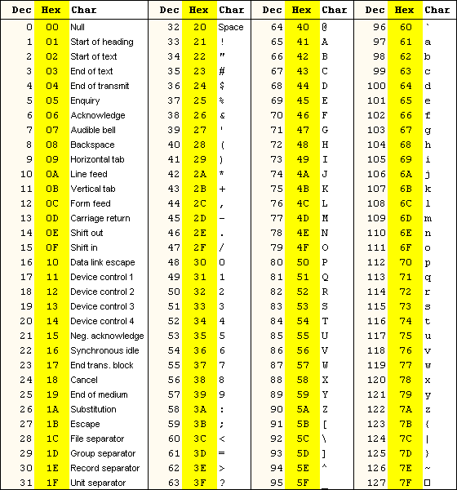

© David Kirk/NVIDIA and Wen-mei Hwu, 2007-2012 ECE408/CS483/ECE498al, University of Illinois, Urbana-Champaign

Slide 37
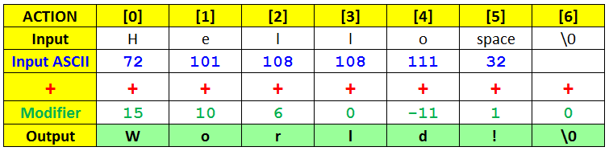
© David Kirk/NVIDIA and Wen-mei Hwu, 2007-2012 ECE408/CS483/ECE498al, University of Illinois, Urbana-Champaign

